Slide 1

Notes:
Welcome to one of the preliminary videos demoing data access for the upcoming energy map and hack in 2023.

Slide 2



Third-party data
(Open) datasets and sources of interest
Energy Map & Hack 2023
Notes:
We’d like to introduce some datasets that could be useful to tackling the problem statements for the hackathon.
These are by no means comprehensive – you can draw from any data that you have access to and are entitled to use. But there are a few open datasets it may be worth checking out.

Slide 3
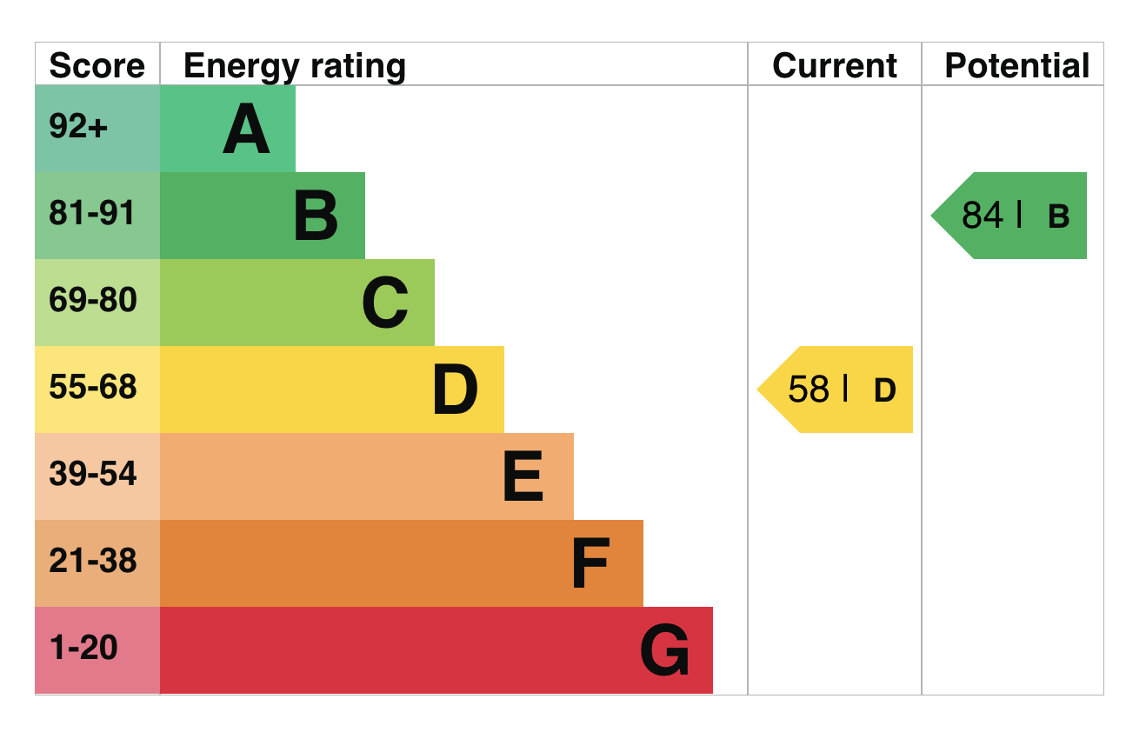
EPC - Building Energy Performance
02
Energy Performance Certificates
Domestic and Non-domestic lookups of energy performance certificates for buildings
Data to “enable independent research into energy efficiency issues such as fuel poverty and climate change”
Available at https://epc.opendatacommunities.org/
Searchable by:
Address
Postcode
Authority
…and more
Notes:
EPC stands for Energy Performance Certificates.
This data is available under an open license and includes energy performance assessments, and recommendations for both domestic and non-domestic buildings.
The data is available online as well as through an API. The API allows you to first search and filter for buildings by various parameters, such as address, postcode and authority. After retrieving a certificate ID it allows for retrieving the data for that building.

Slide 4
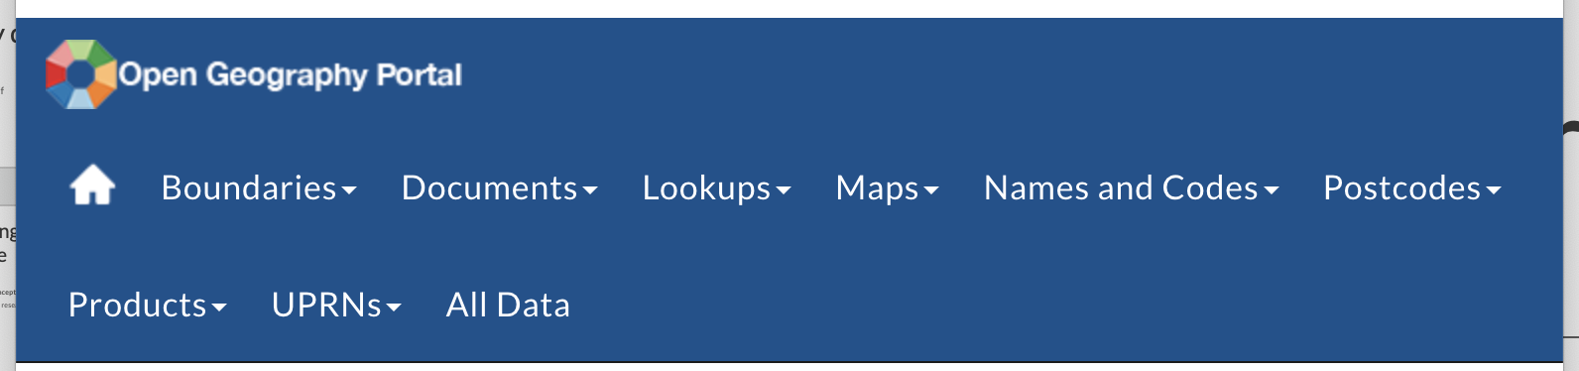
Statistical boundaries and hierarchies
02
Office for National Statistics Geoportal (https://geoportal.statistics.gov.uk)
The ONS Geoportal provides geodata for a huge variety of statistical geographies
Useful for mapping in relation to data about people – population, local authority areas, deprivation
Different kinds of data (with many formats available)
Boundaries
Postcode products
UPRN lookups
Notes:
When looking at different areas of the UK in terms of communities, towns, cities, rural and urban, an essential data source is the ONS Geoportal
This includes boundaries, hierarchies and lookups for various administrative, statistical and socioeconomic areas in the UK.
It can be an essential source of information for also tying together data released at different geographies. For example, converting between postcode level data and census-based geographies.

Slide 5
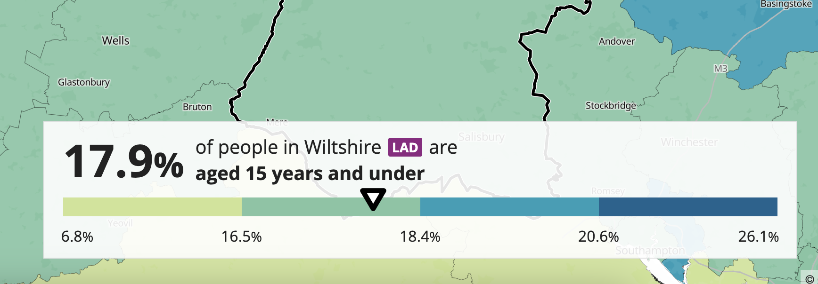
ONS Census Data
02
Data about people
Various datasets relating to results from the 2021 (and previous) Census
See https://census.gov.uk/ for up to date news and data releases
Released against various administrative and statistical geographies
Maps at https://www.ons.gov.uk/census/maps
Notes:
Useful data analysis needs to be people-centric.
One of the best sources of data about people is Census data, compiled by the Office for National Statistics.
To get an idea of the data held you can use the ONS Census map explorer, as displayed here where I’m browsing different geographic areas and looking at age of population.

Slide 6
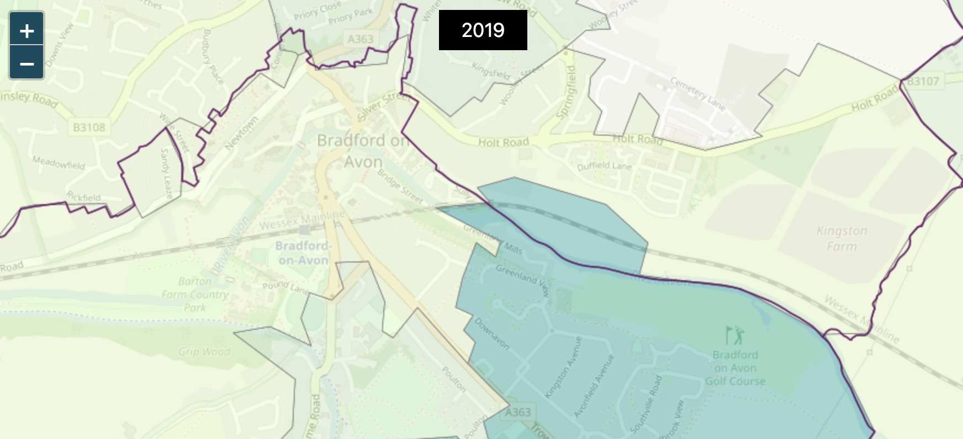
Deprivation indicators
02
Indices of multiple deprivation (latest: 2019)
A set of data to inform about the deprivation of small area geographies https://www.gov.uk/government/statistics/english-indices-of-deprivation-2019
Assesses and ranks small areas in England and Wales across 7 main measures:
Income
Employment
Education
Health
Crime
Barriers to Housing and Services
Living Environment
Notes:
A long-term key dataset in supporting vulnerable communities is the indices of multiple deprivation.
These rank small areas across England and Wales by 7 main measures. In this way we can get a good idea of the deprivation, vulnerability and needs of very small areas. There are similar measures both for Scotland and Northern Ireland, released separately.

Slide 7

Thank you!
Contact
Dave Rowe
dave.rowe@os.uk
Become a member at:
www.geovation.uk
Follow us on Twitter: @geovation
Or drop by the Hub in London
Sutton Yard 4th floor
65 Goswell Road London
EC1V 7EN
GEOVATION FROM ORDNANCE SURVEY

